Slide 1

AUTOMATED TIMETABLE SCHEDULING SYSTEM USING BACKTRACKING ALGORTIHM
Costelo, Hernando Jr. J.
Gaetos, Michelle Emmanuel S.
Javier, Johnuel M.
Lavilla, Ren Russel E.
Quijano, Lester Q.
Nabablit, Karlo Jose E.
Topacio, Raven M.
Thesis Adviser
Technical Critic

Slide 2





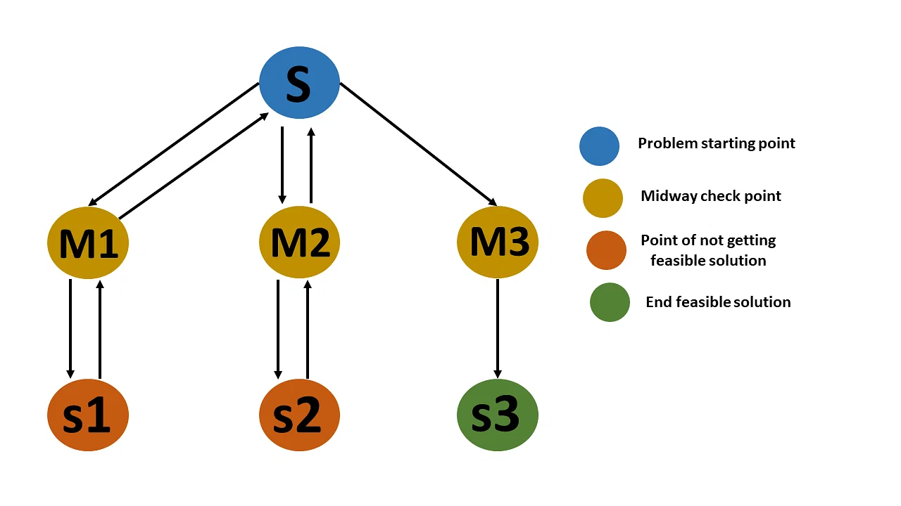
Web-based
Schedules
AUTOMATED TIMETABLE SCHEDULING SYSTEM (ATS)
Dynamic
Automated
Backtracking Algorithm

Slide 3



Significance of the study
Scheduling
Committee
CVSU CCAT CAMPUS
Generation of Reports

Slide 4

OBJECTIVE OF THE STUDY
The main objective of the study was to create a dynamic web-based scheduling system capable of generating conflict-free schedules. The system specifically caters to the scheduling needs of Cavite State University-CCAT Campus especially in Department of Computer Studies faculty, effectively eliminating the need for manual scheduling.

Slide 5






SPECIFIC OBJECTIVES
1. Document and analyze the existing process of scheduling classes in Cavite State University – CCAT;
2. Design and develop a web application that automate the generation of class schedules;
3. Test the reliability of generated schedules based on testing conditions and test the functionality of system modules.
4. Evaluate the system using modified ISO-IEC 25101 software evaluation instrument; and
5. Create an implementation plan for the deployment of the software.

Slide 6

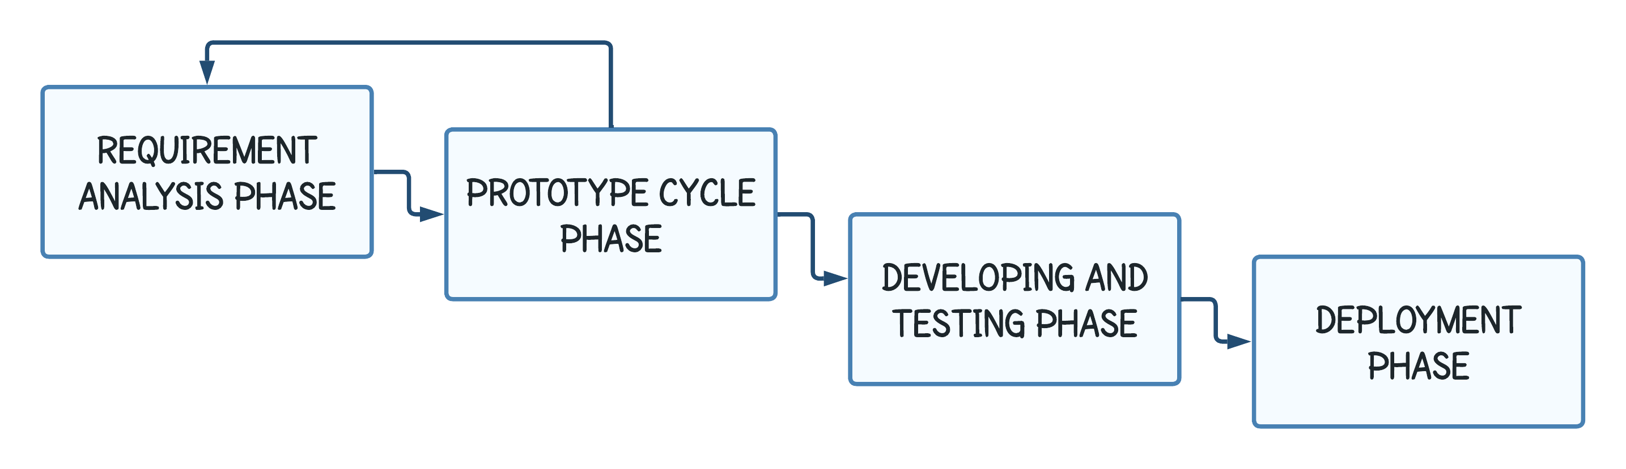
METHODOLOGY

Slide 7
TESTING AND EVALUATION
Test the reliability of generated outputs based testing condition below
TESTING CONDITION | REMARK
1. Teachers, Students and Rooms must have a conflict-free generated schedules. | Passed or Failed
2. The timeslot duration must align with the subject hours. | Passed or Failed
3. The generated output should be free of conflicts. | Passed or Failed
4. The Manual added schedule should not overlap with the existing schedules. | Passed or Failed
5. The room type should be corresponded to the subject type. | Passed or Failed
Test the functionality of system modules using the test case below:
TEST CASE ID | OBJECTIVE | EXPECTED RESULT | ACTUAL RESULT | NUMBER OF DEBUGGED
EVALUATE USING ISO-IEC 250010
DATA ANALYSIS
SCORE | INTERPRETATION
4.51 -5.00 3.51 - 4.50 2.51 - 2.50 1.51 - 2.50 1.00 - 1.50 | Excellent Very Satisfactory Satisfactory Unsatisfactory Needs Improvement
AVERAGE MEAN | Excellent

Slide 8

RESULTS AND DISCUSSION
Results acquired through testing the reliability of generated outputs.v
TESTING CONDITION | REMARK
1. Teachers, Students and Rooms must have a conflict-free generated schedules. | Passed
2. The timeslot duration must align with the subject hours. | Passed
3. The generated output should be free of conflicts. | Passed
4. The Manual added schedule should not overlap with the existing schedules. | Passed
5. The room type should be corresponded to the subject type. | Passed

Slide 9
RESULTS AND DISCUSSION
The test results observed when evaluating the functionality of system modules using the provided test case.
TEST CASE ID | OBJECTIVE | EXPECTED RESULT | ACTUAL RESULT | NUMBER OF DEBUGGED
T-001 | Test the login module | The system must not allow to login the unregistered user, | Unregistered login was blocked the system. | 1
T-002 | Test the register module | If the user registers a new account with a same email, The system must not allow the registration of the account, | Same email used in registration process was blocked by the system. | 1
T-003 | Test faculty loading module | The same teacher should not have a same assigned subject with same sections. | The system prompts a message “The subject was already assigned with the same teacher!” | 1
OBJECTIVE

Slide 10
RESULTS AND DISCUSSION
Summary of IT Experts Evaluation Results
Characteristics | Average Score | Descriptive Interpretation
1. Functional Suitability | 4.16 | Very Satisfactory
2. Performance Efficiency | 4.56 | Very Satisfactory
3. Usability | 4.35 | Very Satisfactory
4. Security | 4.05 | Very Satisfactory
5. Maintainability | 4.24 | Very Satisfactory
6. Portability | 3.6 | Satisfactory
Average Mean | 4.16 | Very Satisfactory

Slide 11
RESULTS AND DISCUSSION
Summary of End-User Evaluation Results
Characteristics | Average Score | Descriptive Interpretation
1. Usability | 4.58 | Excellent
Effectiveness | 4.8 | Excellent
Efficiency | 4.7 | Excellent
Satisfaction | 4.7 | Excellent
5. Context Coverage | 4.75 | Excellent
Average Mean | 4.70 | Excellent

Slide 12

SUMMARY
The system was evaluated by 40 respondents, including 10 IT Experts and 30 End-users. The IT Experts evaluation results indicating a Very Satisfactory overall performance. The End-users provided feedback stating that the system is user-friendly, accessible, trustworthy, adaptable, useful, and comfortable, resulting in an average mean score of 4.70, indicating a highly satisfactory level of performance.

Slide 13

CONCLUSION
In conclusion, our system underwent thorough evaluation by IT experts and end users, resulting in highly positive assessments. The evaluation by IT experts highlighted the system's very satisfactory performance across various aspects, including functionality, performance, usability, security, maintainability, and portability. The system effectively met requirements, delivered efficient performance, and provided a user-friendly experience. The evaluation by end users also revealed excellent performance in terms of usability, effectiveness, efficiency, satisfaction, and context coverage. Overall, the evaluation results demonstrate the system's exceptional performance, effectiveness, and user satisfaction, making it highly satisfactory and excellent.

Slide 14

RECOMMENDATION
Printing Specific Schedules: Allow users to easily print specific schedules directly from the system.
User and Teacher Management: Introduce a user management system that enables administrators to add and manage user accounts. Additionally, provide teachers with access to view schedules online.

Slide 15

REFERENCES
Al-Jarrah, M. A., Al-Sawalqah, A. A., & Al-Hamdan, S. F. (2017). Developing a course timetable system for academic departments using genetic algorithm https://www.researchgate.net/profile/Sami-Hamdan-4/publication/313487752_Developing_A_Course_Timetable_System_for_Academic_Departments_Using_Genetic_Algorithm/links/601b7a55299bf1cc26a00768/Developing-A-Course-Timetable-System-for-Academic-Departments-Using-Genetic-Algorithm.pdf
“Simplelearn” (2022), What Is Data Collection: Methods, Types, Tools, and Techniques https://www.simplilearn.com/what-is-data-collection-article
Ben Moreland, (2015), Hard and Soft timetabling constraints. https://educationspaceconsultancy.com/hard-and-soft-timetabling-constraints-not-only-a-working-timetable-but-a-great-timetable/
Edmund Kieran Burke, Sanja Petrovic (2002), Recent research directions in automated timetabling https://doi.org/10.1016/S0377-2217(02)00069-3
Soni Upadhyay (2023), Introdcution Backtracking algorithm https://www.simplilearn.com/
Zina Houhamdi, Belkacem Athamena, Rani Abuzaineddin, Mohammad Muhairat (2019), A Multi-Agent System for Course Timetable Generation. https://www.researchgate.net/publication/331995150_A_multi-agent_system_for_course_timetable_generation
Ahmed Gad (2018), Introduction to Optimization with Genetic Algorithm. https://www.kdnuggets.com/2018/03/introduction-optimization-with-genetic-algorithm.html
Related System
“Neon Projects” (2015), Automated College Timetable Generator. https://nevonprojects.com/automated-college-timetable-generator/
Gamale, Jeralyn M., Anuta, Edward C., Sayson, Zina D. (2011), Automated Scheduling System Capstone Project. https://capstoneguide.com/automated-class-scheduling-system-capstone-project-document/
John Benedict C. Legaspi, Roman M. De Angel, Ace C. Lagman, John Heland Jasper C. Ortega (n.d), Web based Course Scheduling System using Greedy Algorithm. https://ijssst.info/Vol-20/No-S2/paper14.pdf
Abhik Mitra (2020), Intelligent Timetable Generator using Genetic Algorithm. http://abhik.pythonanywhere.com/
Loic Ngou (2019), Timetable Generator using Genetic Algoritmh. https://Timetable Generator
https://www.freecodecamp.org/news/backtracking-algorithms-recursive-search/

Slide 16

ACKNOWLEDGEMENT
We express our sincere gratitude to the following individuals for their unwavering support, guidance, and assistance throughout our journey:
Our Family for supporting us financially and emotionally.
We would like to extend our heartfelt gratitude to the faculty members of CVSU CCAT Campus, particularly from the Department of Computer Science (DCS). Their expertise, guidance, and support have been instrumental in our journey, and we deeply appreciate their contributions.
We would like to express our sincere gratitude to Mr. Raven M. Topacio for his invaluable assistance in completing our system. His expertise, guidance, and support have been instrumental in overcoming challenges and achieving our goals. We deeply appreciate his contributions.
We also extend our heartfelt thanks to Mr. Karlo Jose E. Nabablit for his motivation and unwavering support. During challenging times, his encouragement and belief in us have been a source of hope and inspiration. We are grateful for his positive influence.
We would like to acknowledge Mr. Aries E. Gelera for his contributions and support throughout our journey. His involvement and assistance have been greatly appreciated.

Slide 17

THANK YOU!

